Slide 1

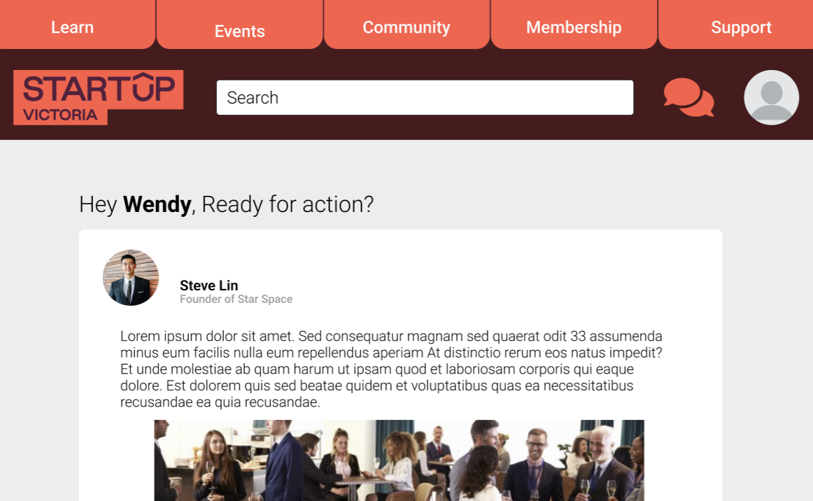
Startup Victoria
Monash Innovation Guarantee 2023
Frank Van
Hylie Tan
#MIG23
James Chilcott
Kevin Xie
Melbourne, VIC
Steve Huynh
Notes:
James

Slide 2

Meet the Team!
1
What's our Agenda?
What's our Challenge?
2
Mapping Stakeholders & Systems
3
Jeremiah's Suit Store! (Storyboarding)
4
The Solution (Prototype)
5
Feedback & Adjustments
6
Notes:
James

Slide 3

Startup Victoria
Are you ready?
Are you ready?
Get to know the Team!
Notes:
James

Slide 4
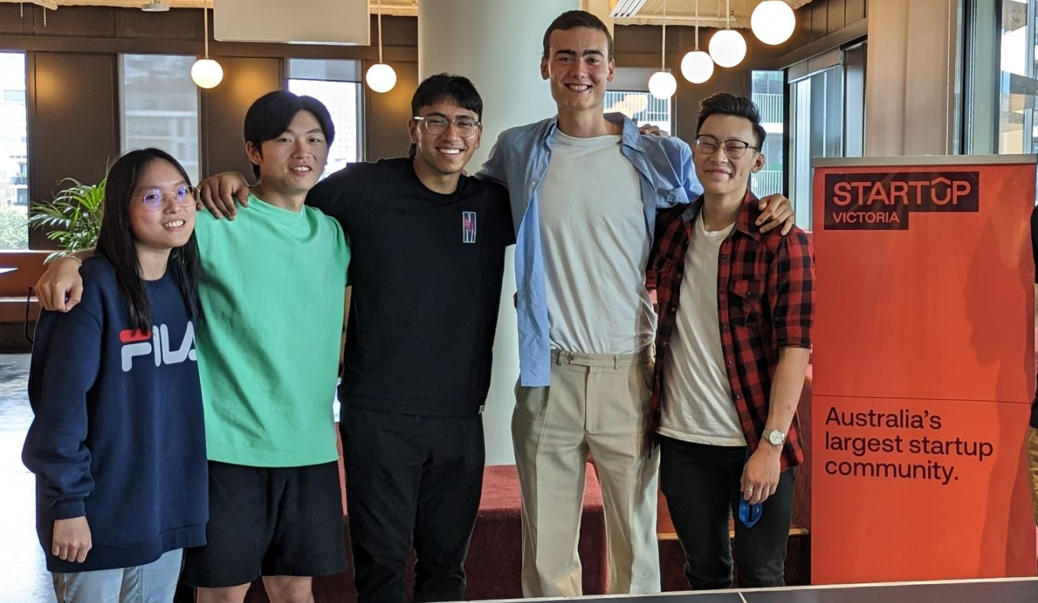
Meet the team!
James: Would rather fight 5 pitbulls than 100 chickens.
Kevin: Great Dancer (ballerina)
Hylie: Would rather hop after a bunny than a kangaroo
Steve: Would rather fight 100 chickens than 5 pitbulls.
Frank: Can bench 100 kg (strong)
Notes:
James

Slide 5

Startup Victoria
Let's break it down!
Are you ready?
Challenge Breakdown!
Notes:
James

Slide 6
What’s the breakdown on our Challenge?
Value: tools, connections, resources, programs & opportunities.
How can Startup Victoria enhance the useability, value and impact of their digital professional member’s portal to better support the startup community across Australia?
Useability: Clear & Intuitive UI, Streamlined accessibility to features and functionality regardless of technical proficiency.
Impact: Measurable results of benefits able to be achieved through utilisation.
Startup Community Target Demographic: Entrepreneurs & Startup Founders, Industry Partners (venture capitalist), Aspiring entrepreneurs.
Support: Guide to help grow and establish.
Notes:
James

Slide 7

Mapping is a great visual tool!
Startup Victoria
Are you ready?
Let's map Problem, System & Stakeholders!
Notes:
James

Slide 8
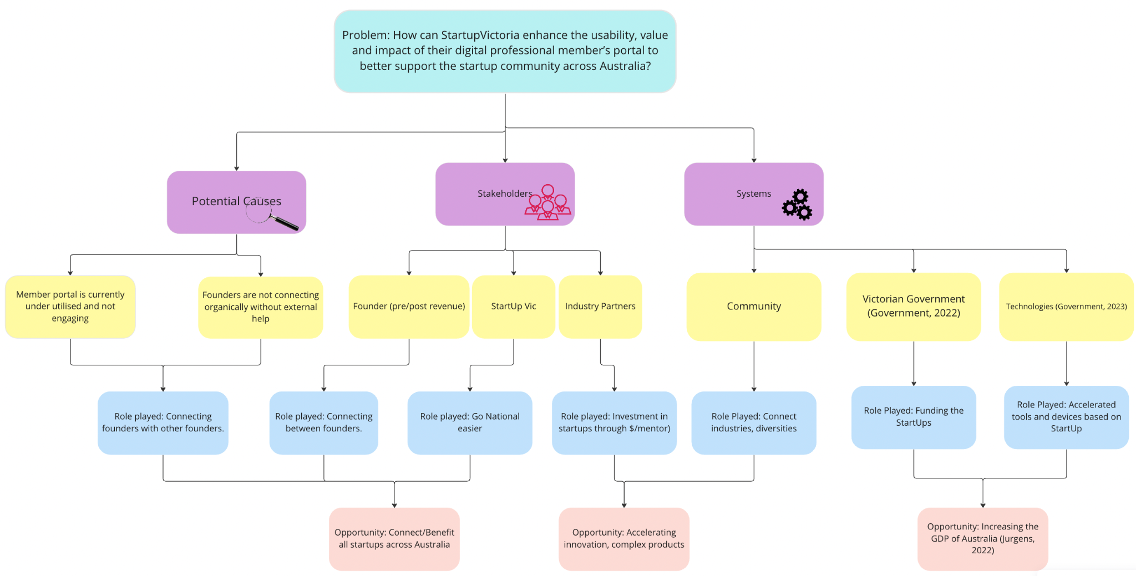
Let’s Map!
Notes:
Steve

Slide 9

Startup Victoria
Jeremiah’s Suit Store (Storyboarding)
Notes:
James

Slide 10
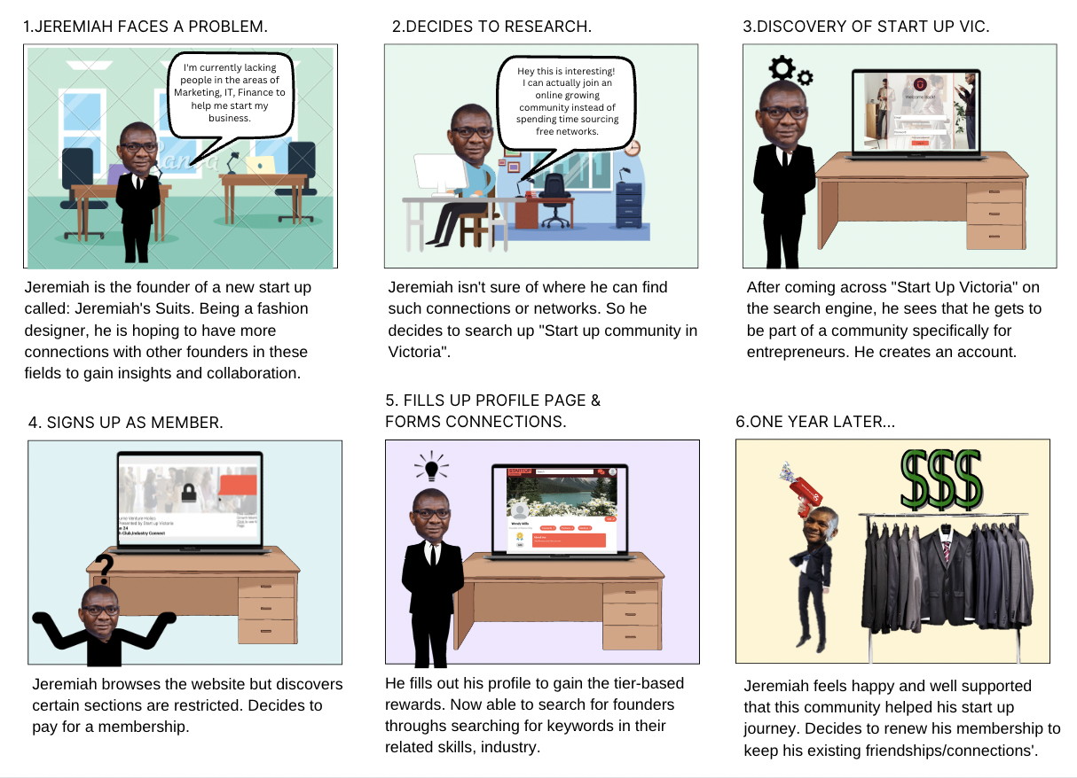
Notes:
James

Slide 11
Startup Victoria
Wow, I am excited!
Are you ready?
The Solution.
Notes:
Steve

Slide 12

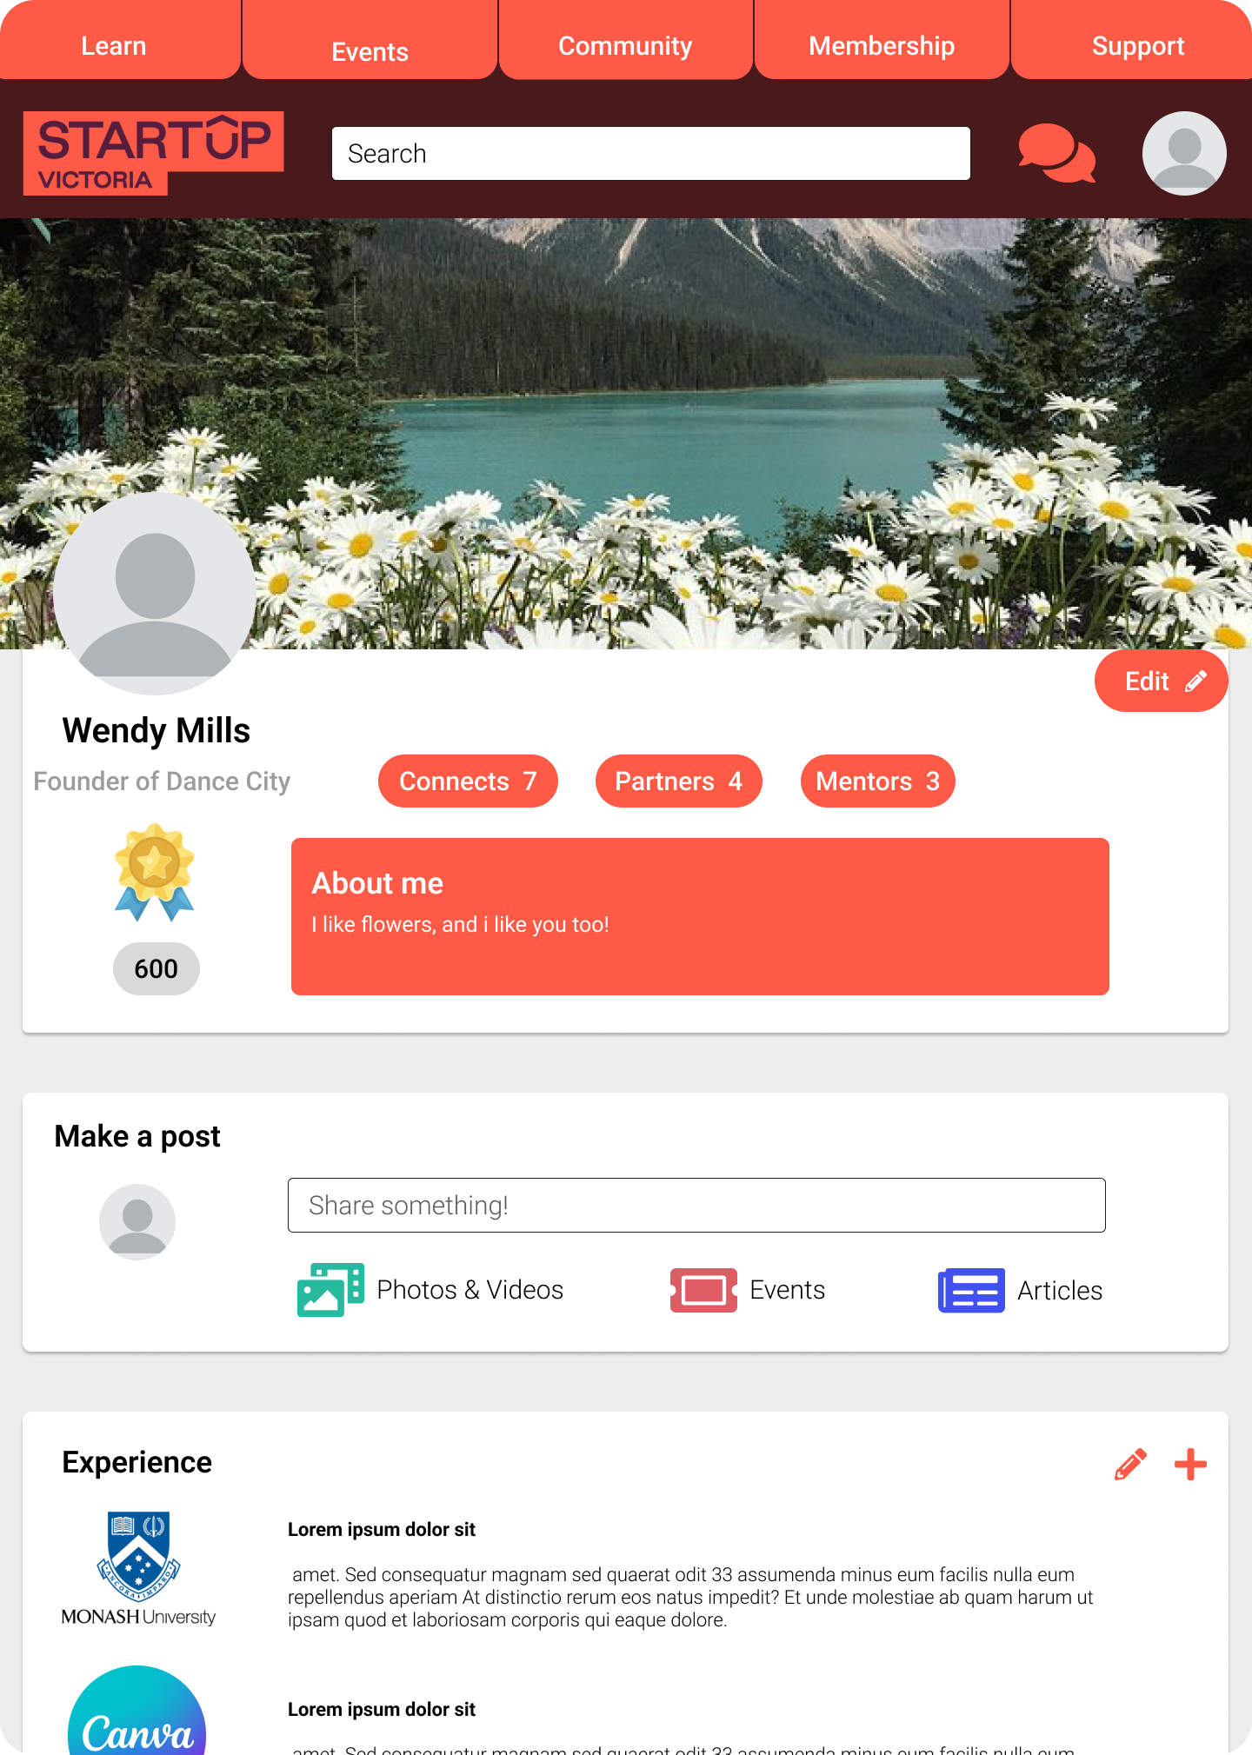
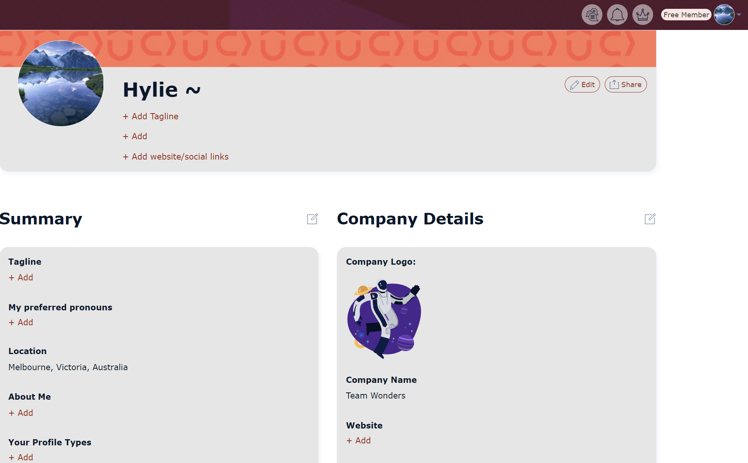

Our Prototype
Profile
Startup Victoria
Before: Manual profile inputs
of info, lacks personality
After: Personalised,
point system
Notes:
Frank

Slide 13
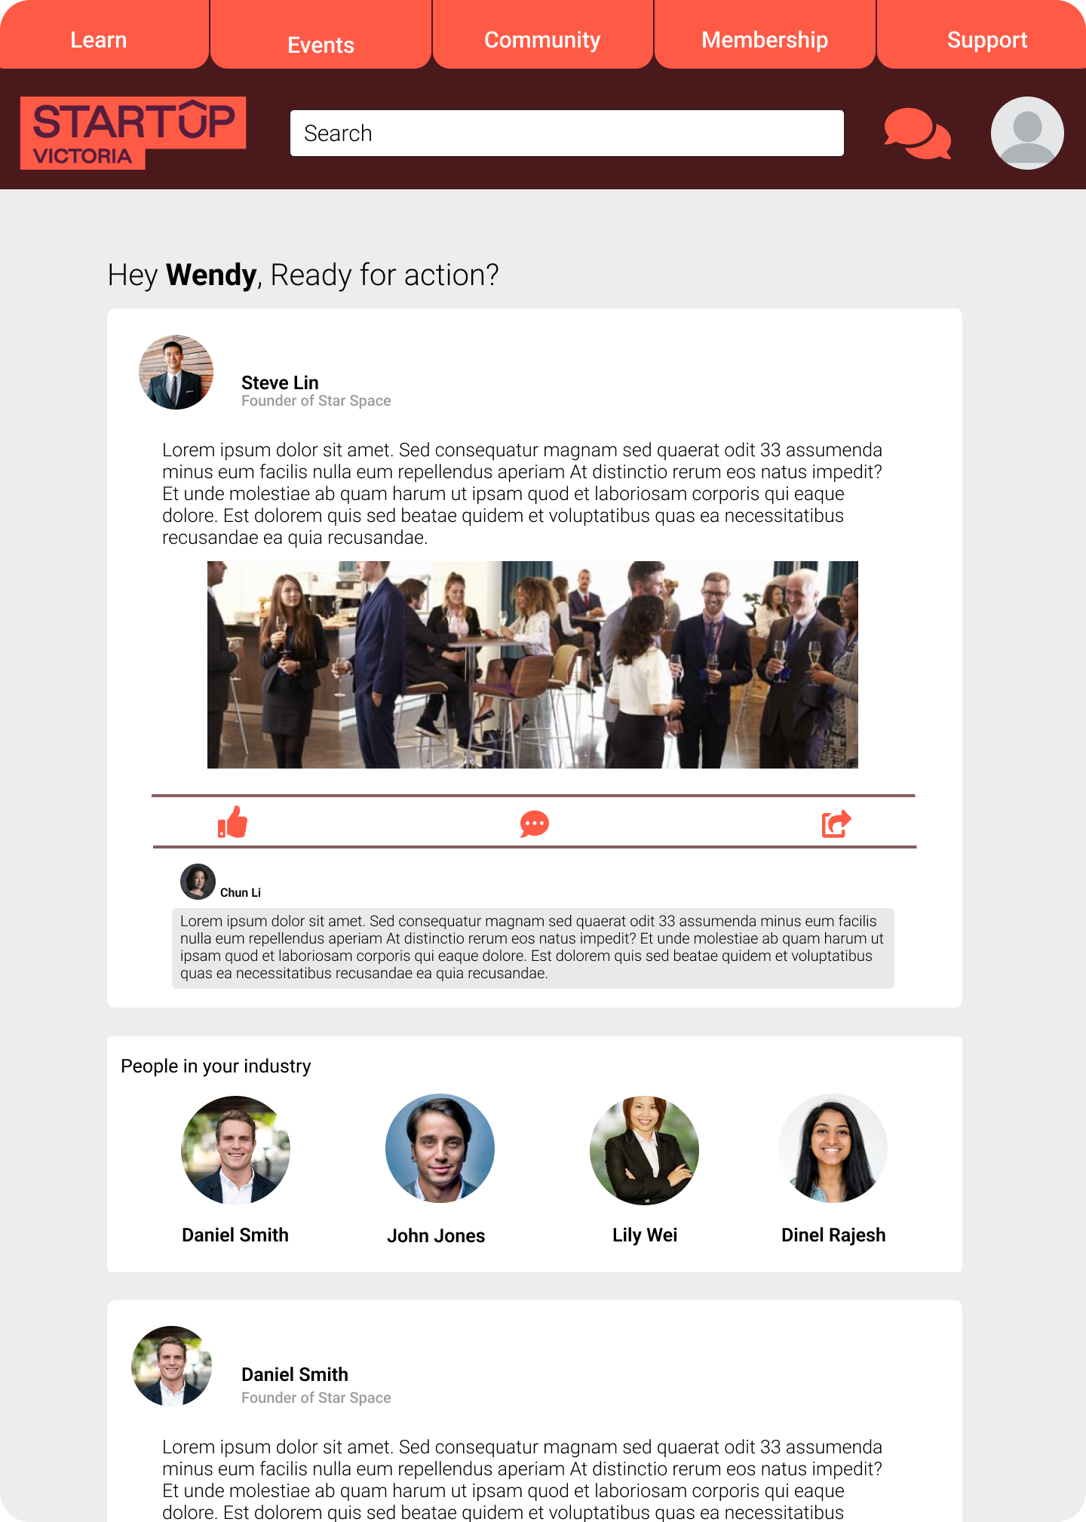
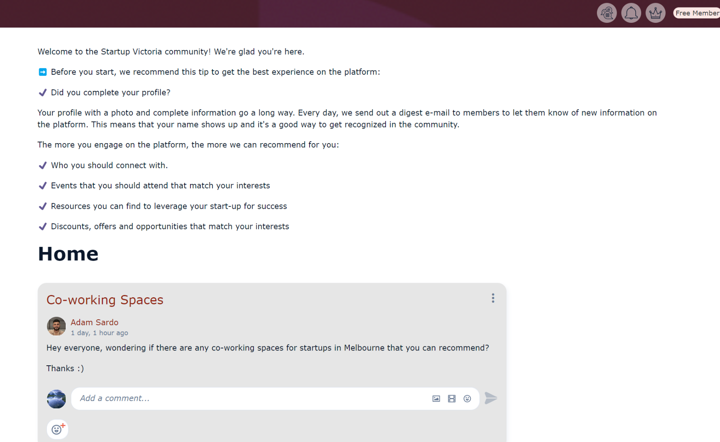
Our Prototype
Home Page
Startup Victoria
Before: Clumped info,
lacks options
After: Tabs streamline experience, more interaction
Notes:
Frank

Slide 14
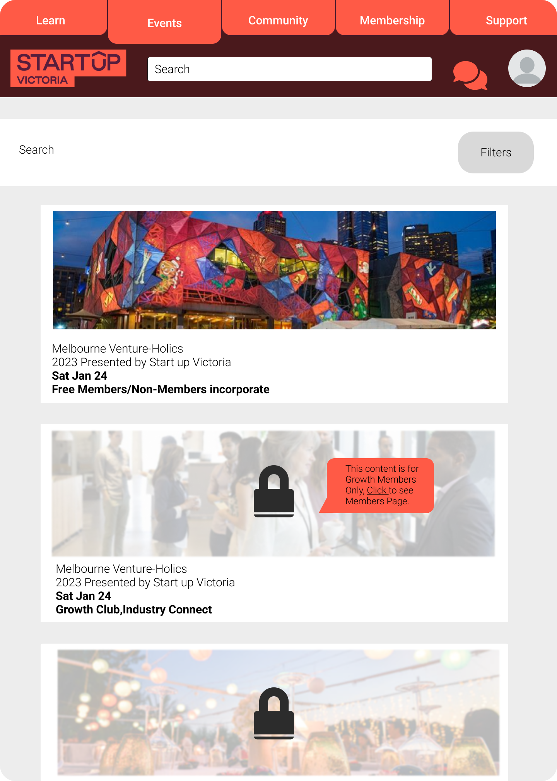
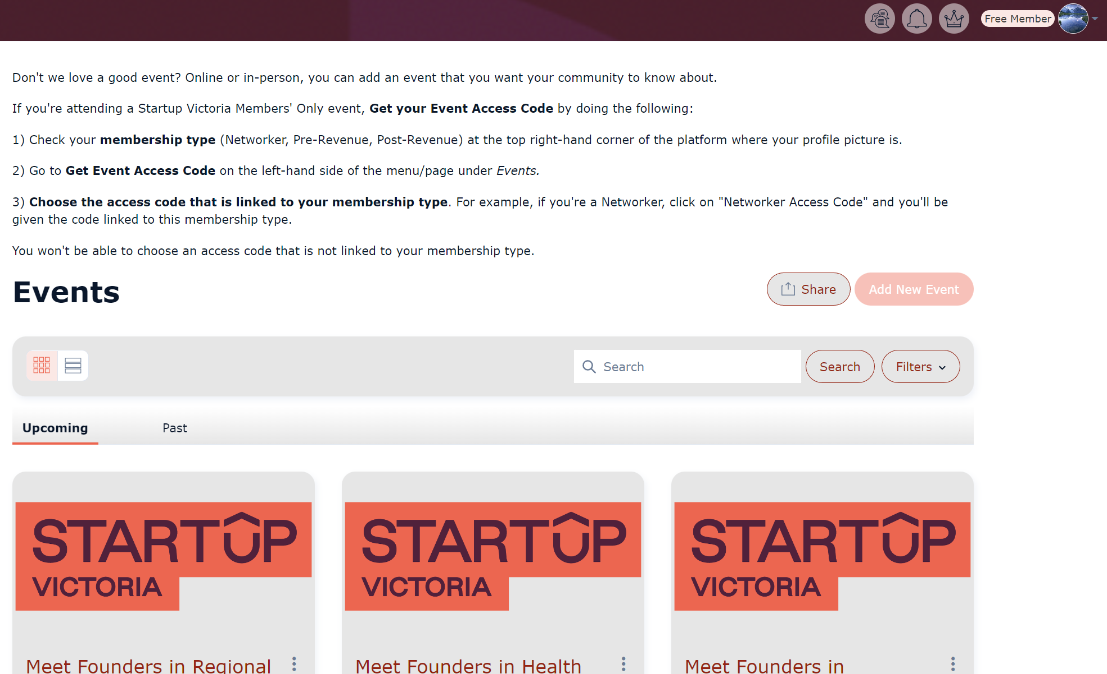
Our Prototype
Events
Startup Victoria
Before: Repetitive,
no member incentive
After: Vibrance,
locking - filters events
Notes:
James

Slide 15
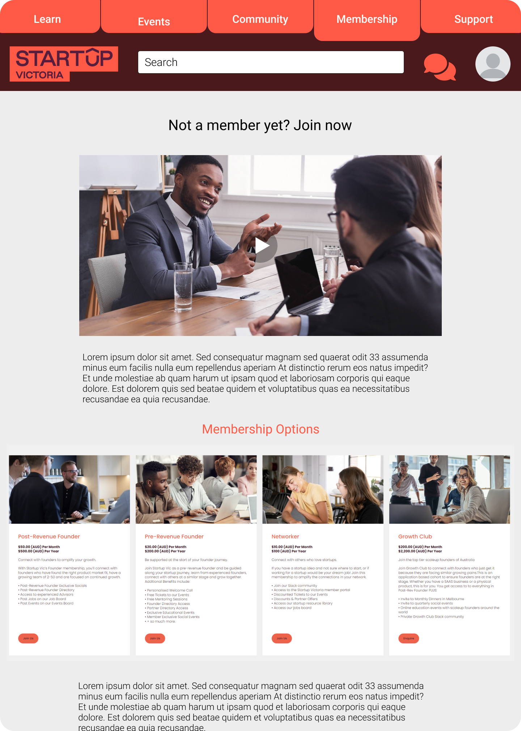
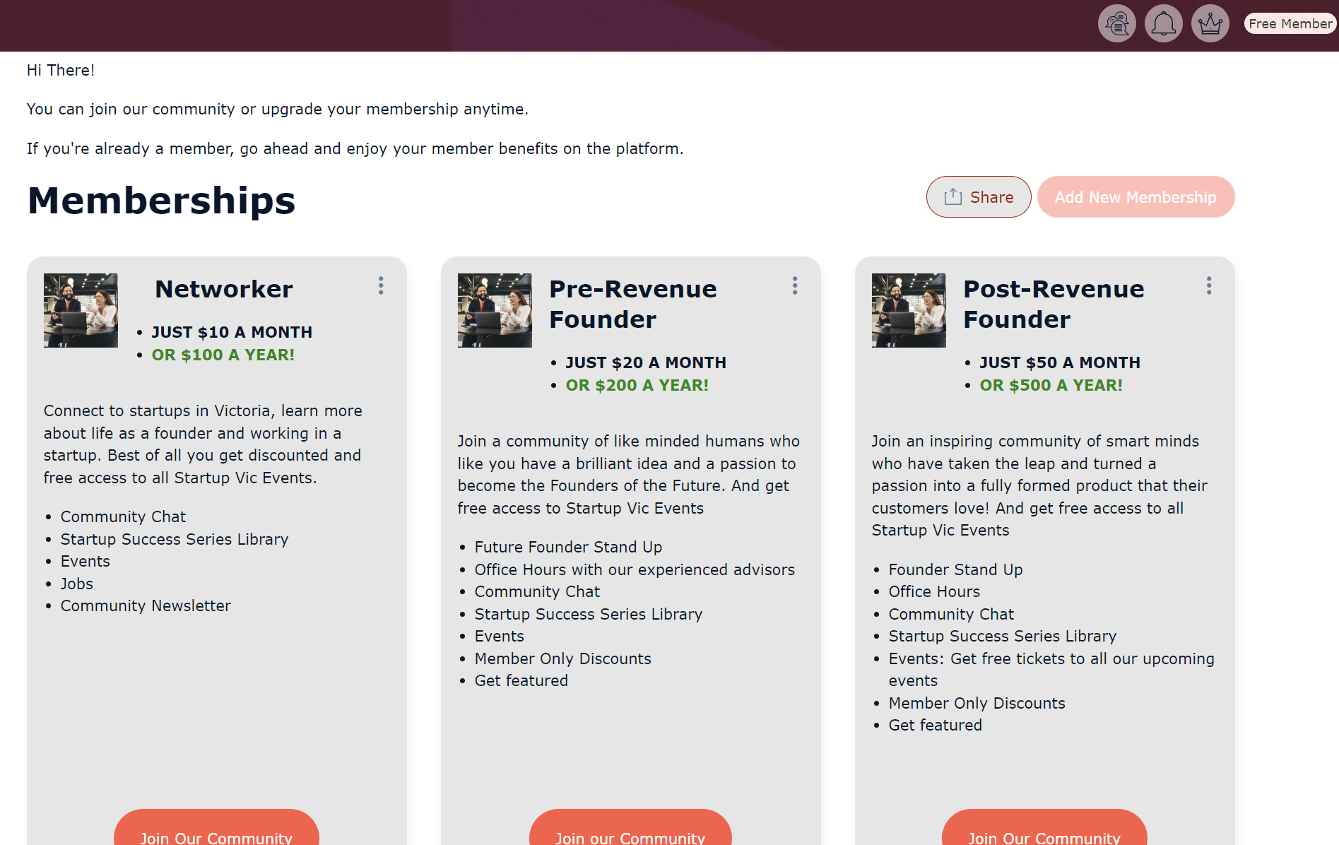
Our Prototype
Membership
Startup Victoria
Before: Lacks incentive to join, no call to action
After: Call to action,
video explanation
Notes:
James

Slide 16
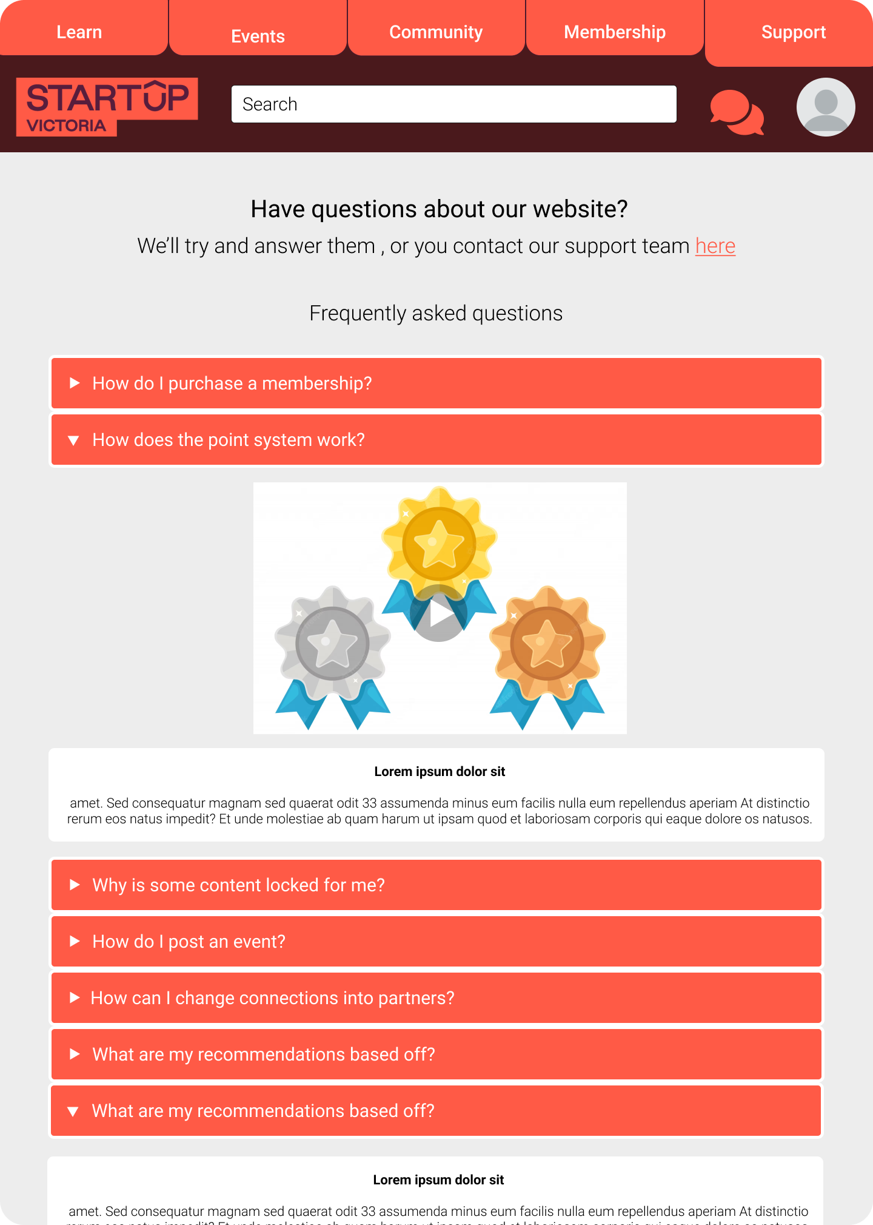
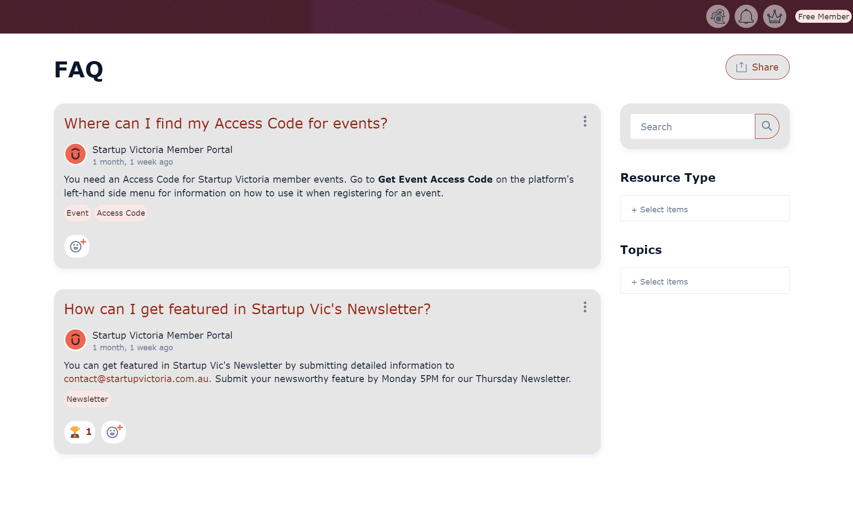
Our Prototype
Support
Startup Victoria
Before: Very spaced out,
not engaging
After: Videos offering understandable answers
Notes:
Steve

Slide 17
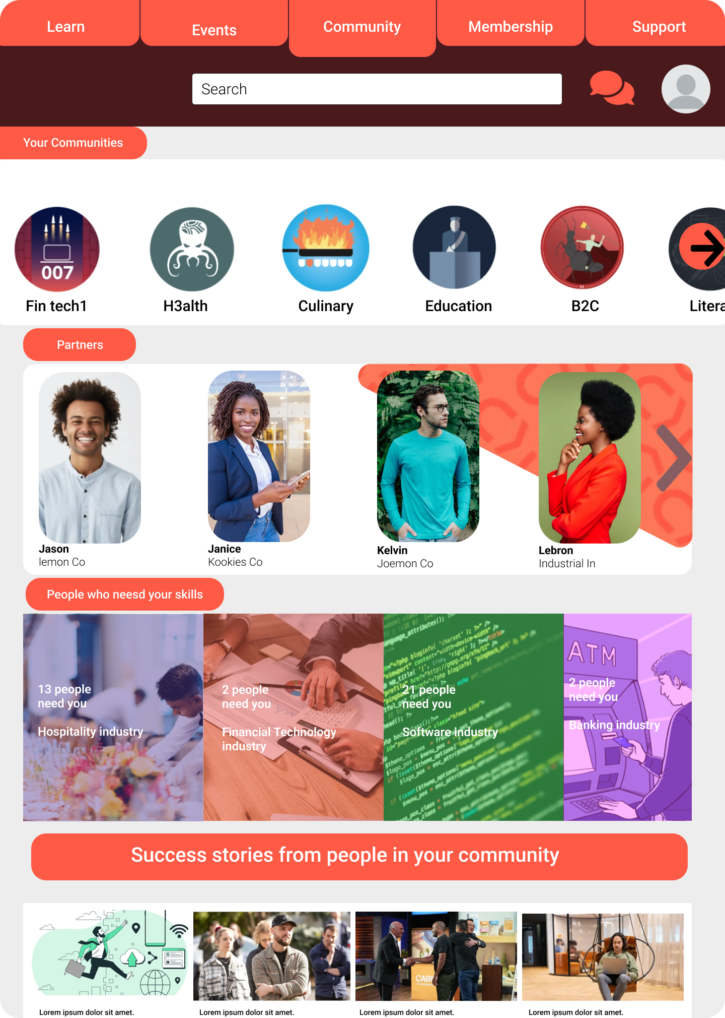
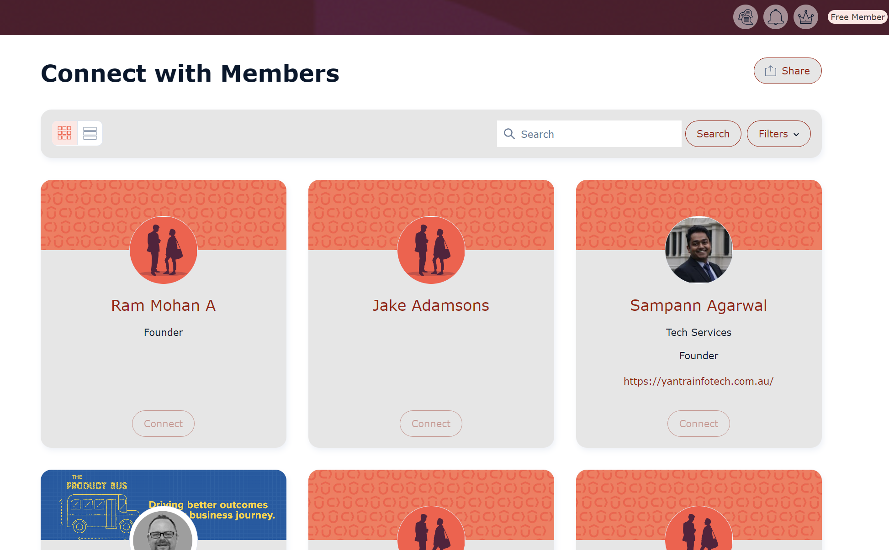
Our Prototype
Community
Startup Victoria
Before: Lacks community, overall user connections, plain
After: Greater community,
partnership, success stories
Notes:
Steve

Slide 18
Startup Victoria
Are you ready?
Feedback & Adjustments
Notes:
Steve

Slide 19
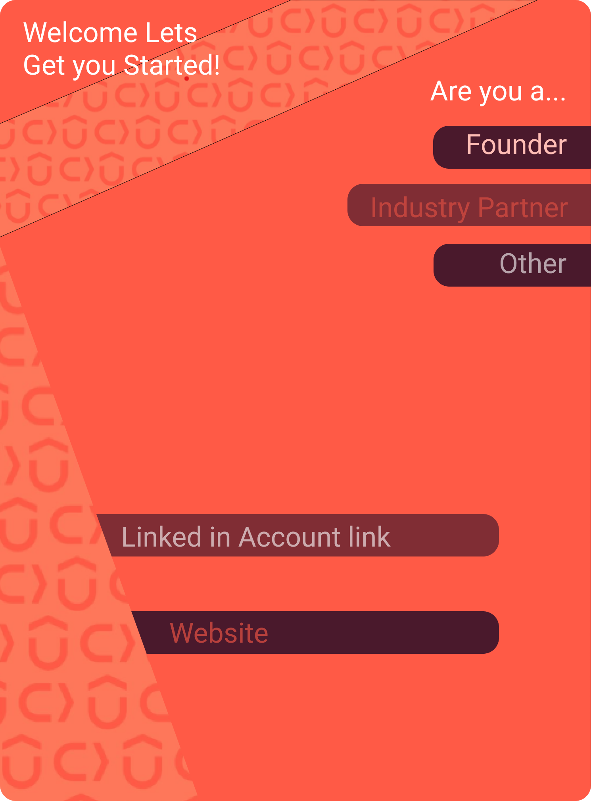
Signup
Startup Victoria
How can I personalise my own homepage to suit my needs?
Differentiate recommendations
Notes:
I need a more efficient method of communicating with businesses and don't have time to navigate through the other features of this platform.

Slide 20
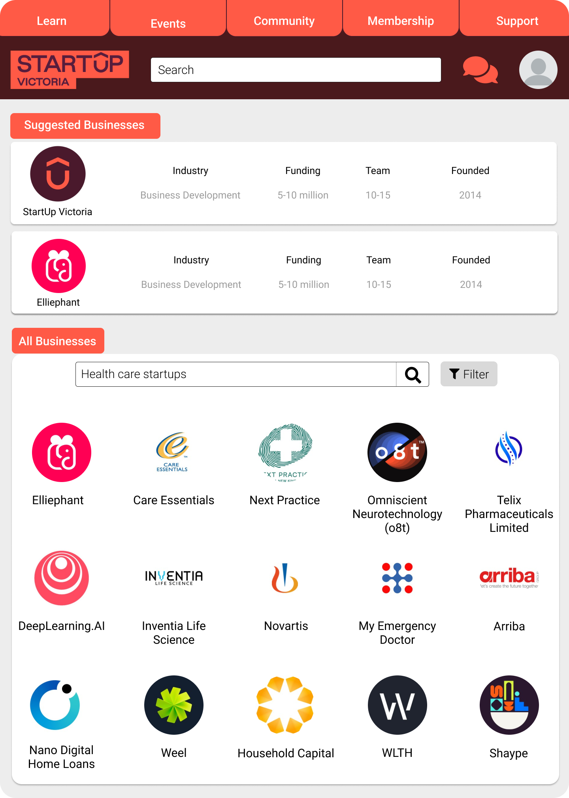
Business Section
Startup Victoria
I can now connect with a wide range of industry partners in my industry!
Filter by niche,
suggested and streamlined.

Slide 21
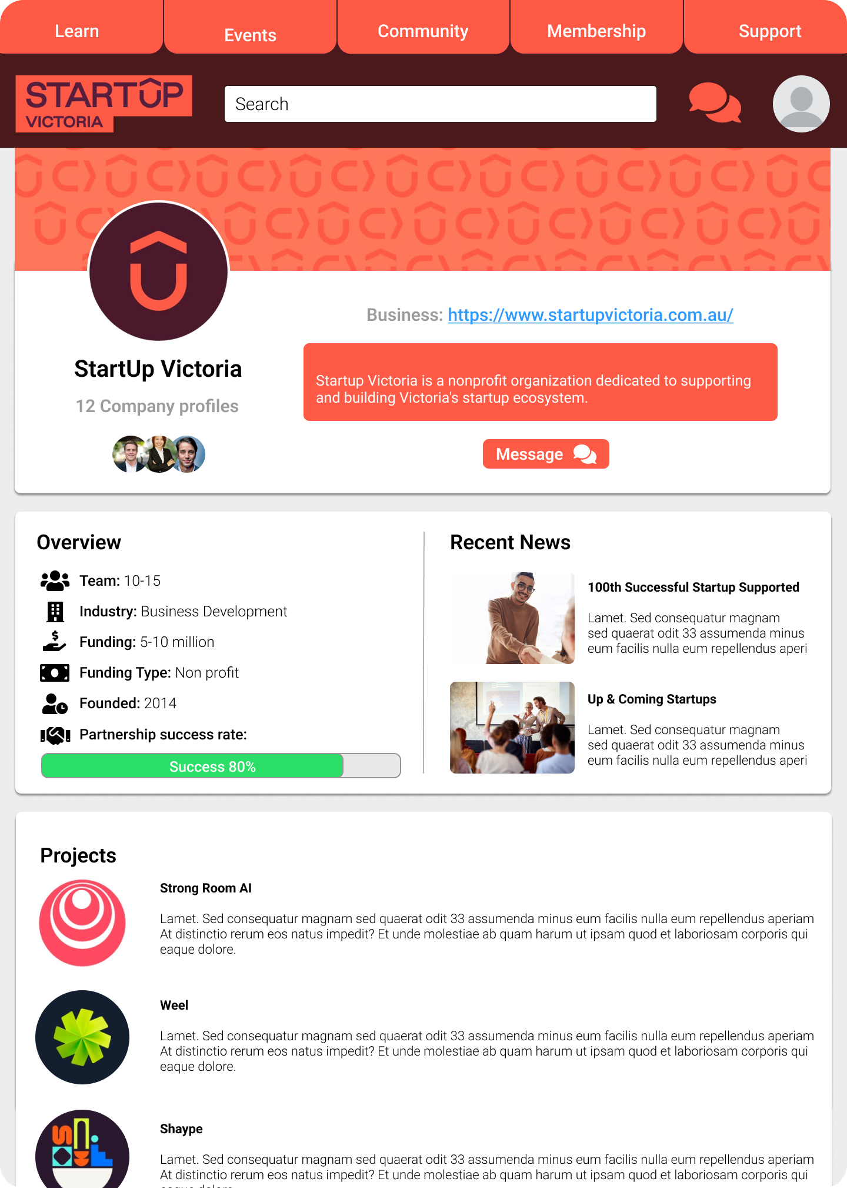
Business Profile
Startup Victoria
I can now showcase my business effectively to industry partners!
Showcase activities.
Industry partners more informed.
Founders advertise.
Notes:
I need a more efficient method of communicating with businesses and don't have time to navigate through the other features of this platform.

Slide 22
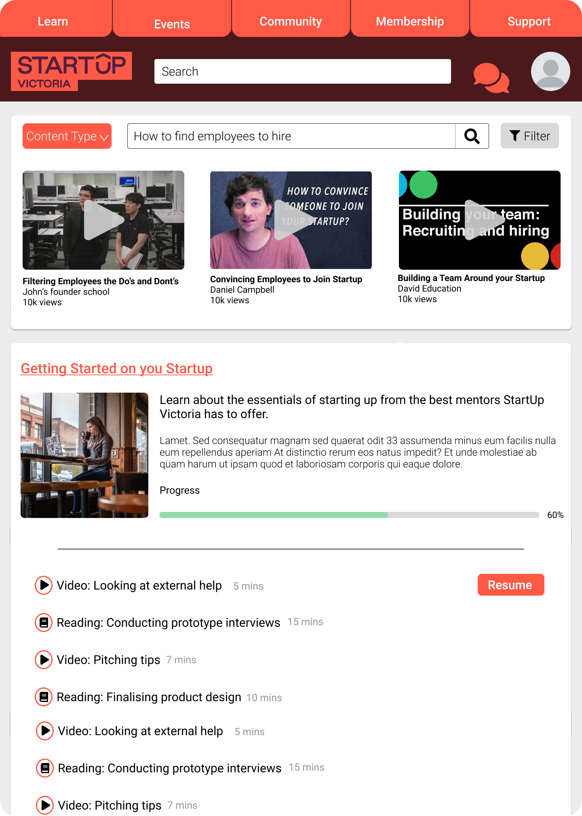
Learning
Startup Victoria
How can I educate myself on informations regarding StartUps?
Unique differentiator.
Courses and bite sized videos.
Understand start up
Notes:
I need a more efficient method of communicating with businesses and don't have time to navigate through the other features of this platform.

Slide 23
Startup Victoria
Are you ready?
What’s our Timeline?
Notes:
Steve

Slide 24
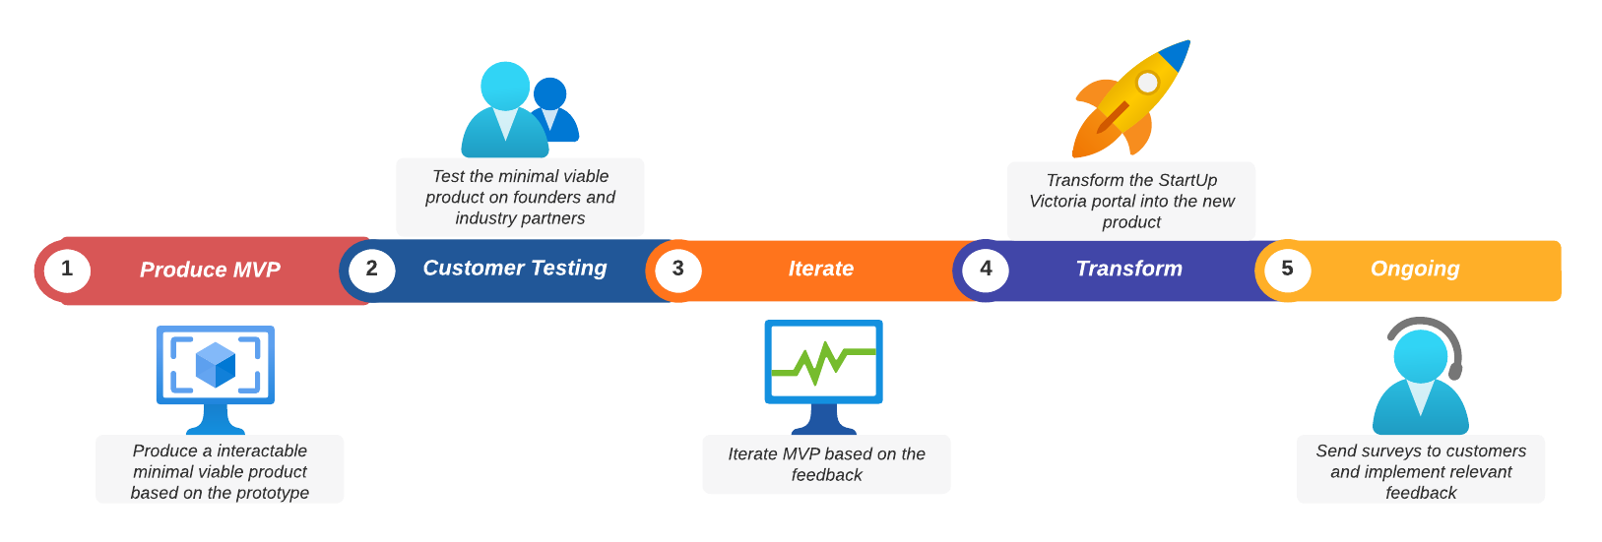
Whats Next?
Notes:
The next steps we will take is produce a mvp and using this mvp undergo customer testing, based on this customer testing we will iterate our mvp. Finally, we will transform the portal to our new product and then release surveys for ongoing support on the portal

Slide 25
Thank You!
Questions?
Notes:
Steve

Slide 26
References
Challenge Breakdown, Problem Mapping:
Government, A. (2023). Competition, Innovation and Productivity in Australian Businesses. Pc.gov.au. https://www.pc.gov.au/research/completed/business-innovation
Government, V. (2022, December 15). Attracting Global Startups To Grow Victorian Jobs. Www.premier.vic.gov.au. https://www.premier.vic.gov.au/attracting-global-startups-grow-victorian-jobs
Jurgens, J. (2022, May 12). How startups drive economic recovery while growing responsibly. World Economic Forum. https://www.weforum.org/agenda/2022/05/how-startups-help-drive-economic-recovery-and-growth/
Storyboarding:
Fishburner. (2022, November 29). Fishburners | Australia’s #1 Coworking & Digital Startup Community. Fishburners. https://fishburners.org/
How to Storyboard: Step-by-Step Storyboarding Guide (2022 Edition) | Boords. (2023, January 11). boords.com. https://boords.com/how-to-storyboard
Khomyn, C. (2023, January 16). 7 Steps of How to Make a Storyboard for a Video: Template, Process, Examples | Bluecarrot. Bluecarrot.io. https://bluecarrot.io/blog/7-steps-of-how-to-make-a-storyboard-for-a-video-professional-tips-and-examples/
Vyond. (2022, December 29). What Is A Storyboard And Why Do You Need One? (With Video). https://www.vyond.com/resources/what-is-a-storyboard-and-why-do-you-need-one/
StartUpVictoria. (2023). Startup Victoria. Startup Victoria. https://www.startupvictoria.com.au/
Sketching:
Lacoma, T. (2016, October 26). Business Sketching Techniques. Small Business - Chron.com. https://smallbusiness.chron.com/business-sketching-techniques-25186.html
PricewaterhouseCoopers. (n.d.). Drawing conclusions: Solving business problems with experience and pencils. PwC. https://www.pwc.com.au/digitalpulse/business-sketching-design-thinking-approach.html
Prototype:
Nordqvist, C. (2020a, October 24). What is a prototype? Definition and examples. Market Business News. https://marketbusinessnews.com/financial-glossary/prototype-definition/
Sajitha. (n.d.-a). How to Create a Product Prototype and Set Your Business. OpenGrowth. https://www.opengrowth.com/resources/how-to-create-a-product-prototype-and-set-your-business
Startup Victoria. (n.d.-a). https://www.startupvictoria.com.au/
TechSydney startup community. (n.d.-a). https://www.techsydney.com.au/
Notes:
Steve

